Slide 1
Singleton Design Pattern
Ensure a class only has one instance, and provide a global point of access to it.

Slide 2
Motivation
It’s importante for some classes to have exactly one instance. There should be only one file system and one window manager. An accounting system will be dedicated to serving one company.
A global variable makes na object accessible, but it doesn’t keep you from instantiating multiple objects.

Slide 3
Benefits
Controlled access to sole instance.
Reduced name space.
Permits refinement of operations and representation.
Permits a variable number of instances.
More flexible than class operations.

Slide 4
How do we ensure that a class has only one instance and that the instance is easily accessible?

Slide 5
A better solution is to make the class itself responsible for keeping track of its sole instance. The class can ensure that no other instance can be created by intercepting requests to create new objects, and it can provide a way to access the instance.

Slide 6
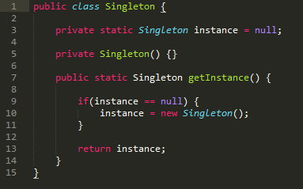
Implementation
Singleton
- Instance : Singleton
- Singleton() + getInstance() : Singleton

Slide 7
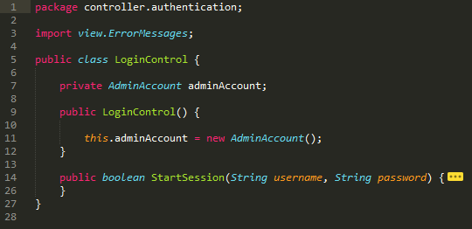
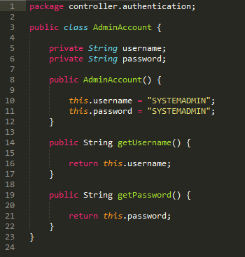
Exemple

Slide 8
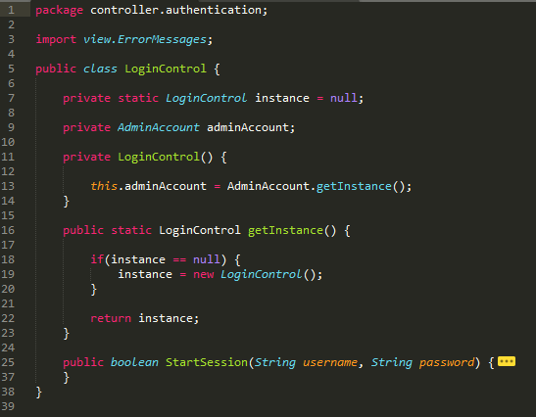
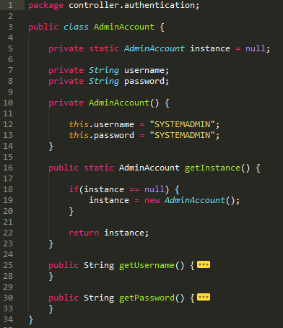
Exemple

Slide 9
Source
> Design Patterns – Elements of Reusable Object-Oriented Software

